Slide 1
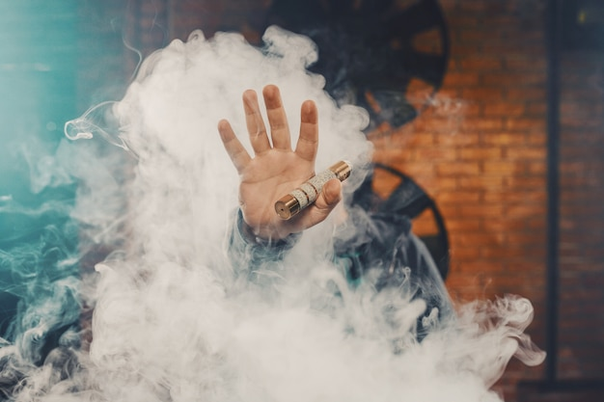
Fêpio
Vaping

Slide 2
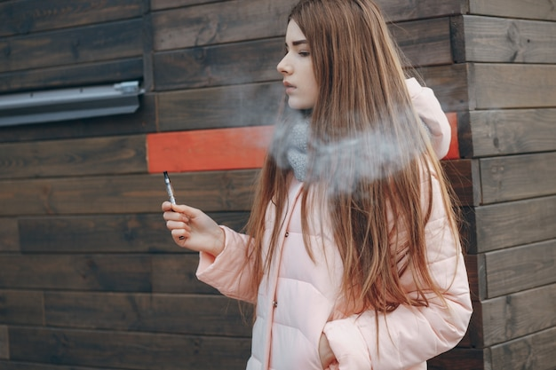
Aim:
To understand the risks
associated with vaping

Slide 3
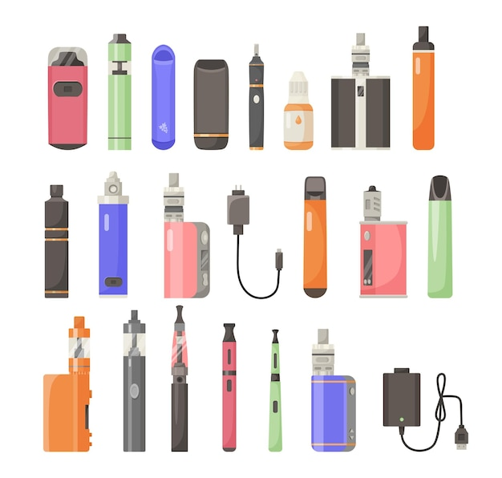
What is a vape?
A battery powered device which allows you to inhale nicotine through a vapour rather than smoke.
3
Notes:
*Also known as electronic cigarettes or e-cigarettes

Slide 4
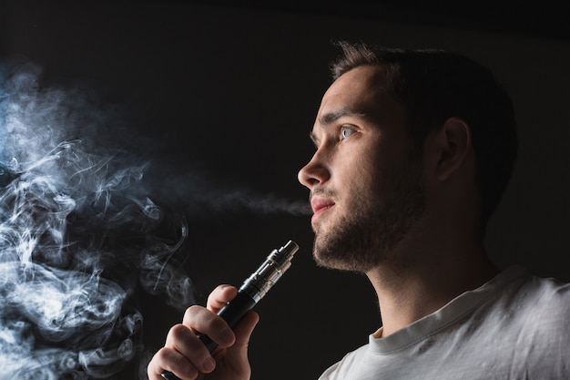
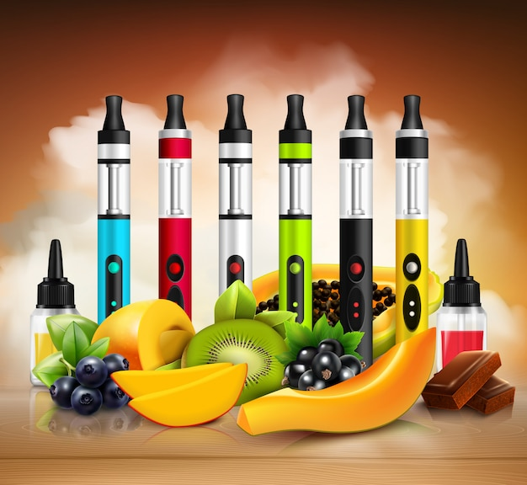
Some young people vape because…
They think it’s a cool accessory
They want to fit in
They like the flavours
They think it’s harmless
Notes:
If somebody is trying to quit smoking, using a vape is safer than smoking tobacco, but they should never be used by non-smokers.
Some young people think of vapes as harmless fun, and something to help them relax and unwind, whilst others are concerned about the risks and dangers involved.

Slide 5
They’re not that bad though, right?
Vapes are not a ‘fun’ gadget, they’re a new, developing product with possible dangers
Some potentially dangerous chemicals have been found in vapes
Teenage brains are more sensitive to nicotine, you can become hooked quickly
High doses of nicotine can affect brain development
Some vape products have the same amount or more nicotine than in a pack of cigarettes
There is some evidence that young people who start using vapes are more likely to use illicit drugs or tobacco.

Slide 6
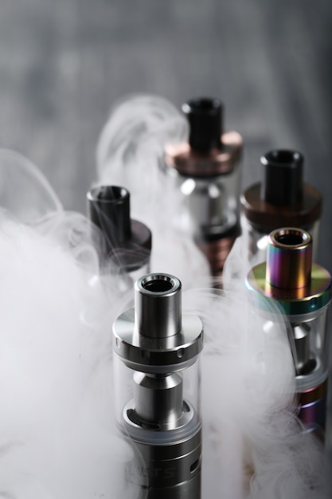
Risks and effects
Some vapes can be so powerful that some users have reported experiencing:
Nosebleeds
Coughing up blood
Headaches
Chest pains
Dizzy spells
Worryingly, the long-term effects are, as yet, unknown.

Slide 7
What we do know…
Young people are drawn to the flavours, brands and various types of vape products – and offenders are likely to use this to their advantage to groom and exploit victims.
Young people are reported to have collapsed in school and subsequently being hospitalised through the use of vapes, one of which containing synthetic THC.

Slide 8
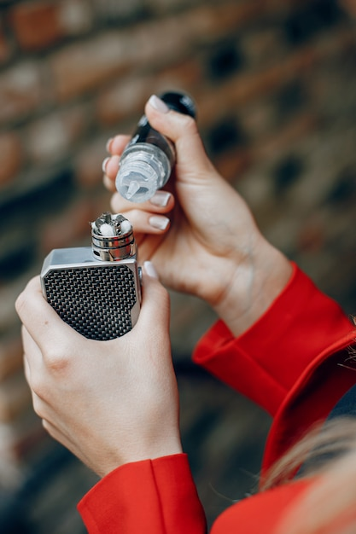
Vaping with Cannabis, CBD and THC
It is even more dangerous than other methods
Both CBD and THC impact a signalling system of your brain which affects your sleep, mood, memory and appetite
THC is psychoactive – it alters the functioning of the brain, causing changes in the way we think, feel and behave.
Notes:
This is a growing concern in Wales.
Cannabis plants are made up of more than 100 different cannabinoids, which have different impacts on the body and are concentrated to different extents in certain parts of the plant. The most well-known of these are THC and CBD. THC is the psychoactive cannabinoid - the one that recreational users use to get "high". CBD does not have this effect.

Slide 9
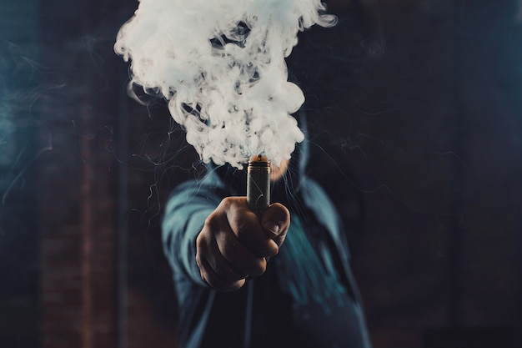
The Law:
In the UK it is illegal to sell nicotine vaping products to someone under the age of 18, or for adults to buy these products for them.
Not all vapes are legal in the UK.
Remember:
Vapes should never be used by non-smokers.
They are not harmless and can be addictive.

Slide 10
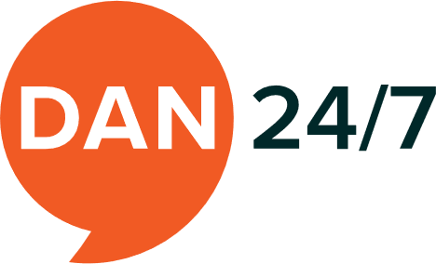
Advice and Support
Teacher or DSL
Schools Police Officer
School Nurse
Notes:
If you have any concerns around the topic of vaping, help and support is available…

